Slide 1
Web-Frameworks
(CS365TDC)
Title: Ai-Powered Medical Laboratory

Slide 2
AI-POWERED MEDICAL LABORATORY
BY:
KIRAN H R– 1RV23CS405
MANOJ KUMAR B V– 1RV23CS407
NAGAPRASAD NAIK– 1RV23CS410
WILSON - 1RV23CS421

Slide 3
INTRODUCTION
AI MedLab is a web based project in which we are predicting the disease on base of symptoms and recommend medicine,diet and workout plan. 7 diseases on base of input values. Uses machine learning trained models. Patients can consult doctor and book appointments.

Slide 4
CURRENT CHALLENGES IN MED-LABORATORY
Human errors in reports and data entry
Delayed diagnosis affects timely treatment
Limited access to quality labs and specialists
Data not used effectively
Generic reports lack personalization
Manual workflows increase workload
No unified system for tests, appointments, and payments

Slide 5
OBJECTIVES
Minimize human errors
Deliver faster test results
Improve access to labs and doctors
Use data to learn and enhance accuracy
Offer personalized reports and advice
Provide a complete platform for bookings and payments
Enable admins to monitor all operations via a dashboard

Slide 6
MODELS AND TECHNOLOGIES
Backend | Nodejs, expressjs, mongoDb, python
Frontend | React.js, Tailwind Css, html, css, javascript
AI Models | Scikit-Learn, Decision_tree, CNN
Softwares | VS Code, Jupyter Notebook, MongoDB Compass

Slide 7
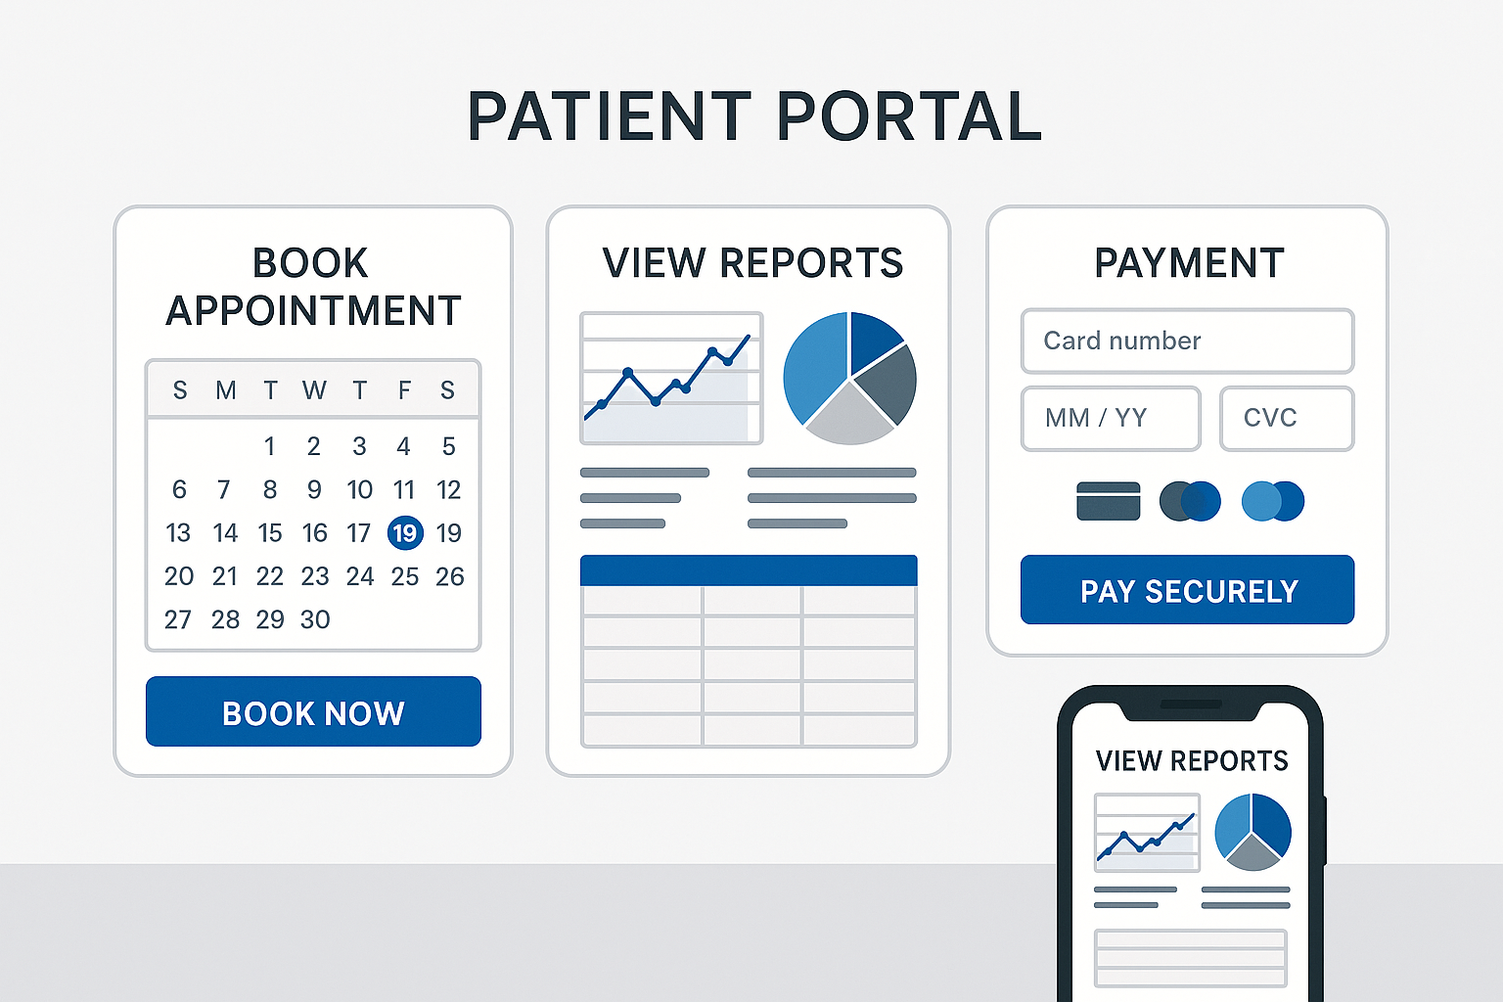
KEY MODULES
Patient Portal:

Slide 8
KEY MODULES
Patient Portal:
Book Appointments with Doctors: Patients can easily choose a doctor, select a time slot, and book an appointment online without visiting the hospital.
View Reports Online: Patients can securely access their lab test reports anytime from their phone or computer, saving time and effort.
Pay Consultation Fees Securely: Patients can pay doctor consultation fees through safe online payment options, ensuring a hassle-free experience.

Slide 9
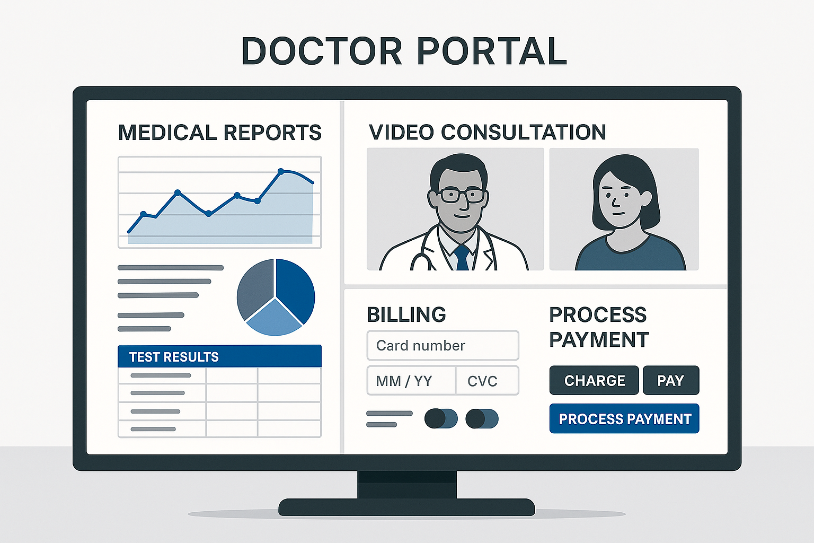
KEY MODULES
Doctor Portal:

Slide 10
KEY MODULES
Doctor Portal:
View Patient Reports: Doctors can easily access detailed lab reports to understand the patient’s condition before or during consultation.
Conduct Consultations: Doctors can provide online or in-person consultations, give advice, and prescribe treatment based on accurate test data.
Charge Fees as Needed: Doctors can set and collect consultation fees securely through the system, making payments simple for both doctor and patient.

Slide 11
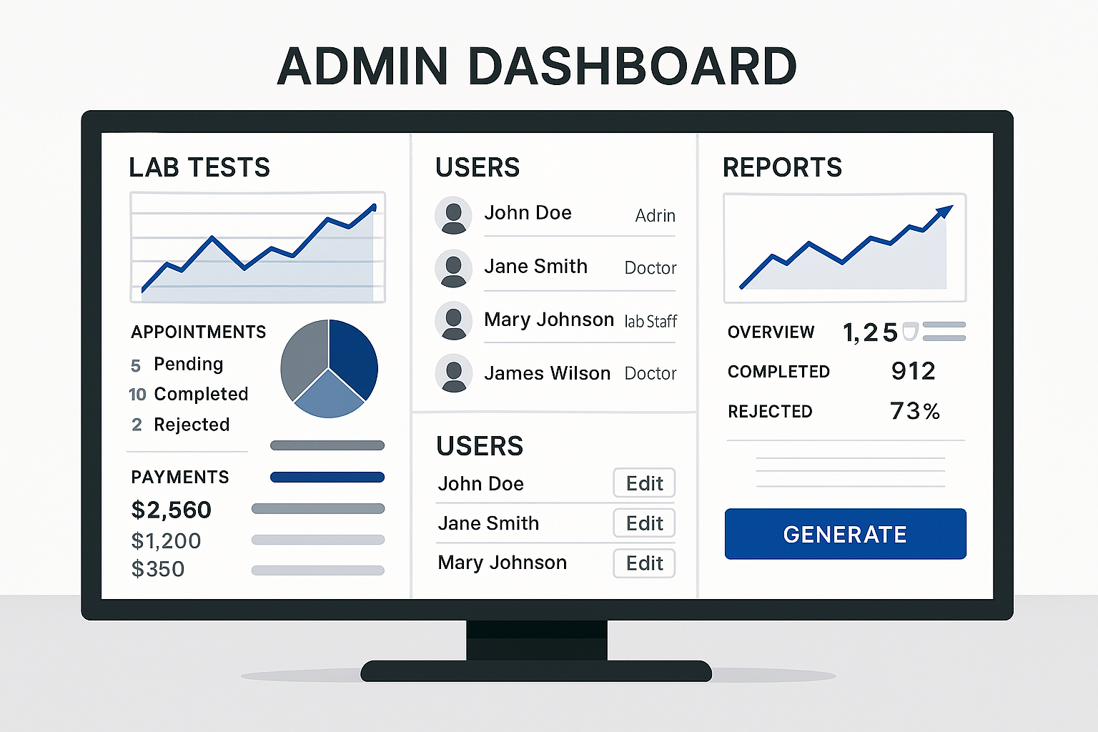
KEY MODULES
Admin Dashboard:

Slide 12
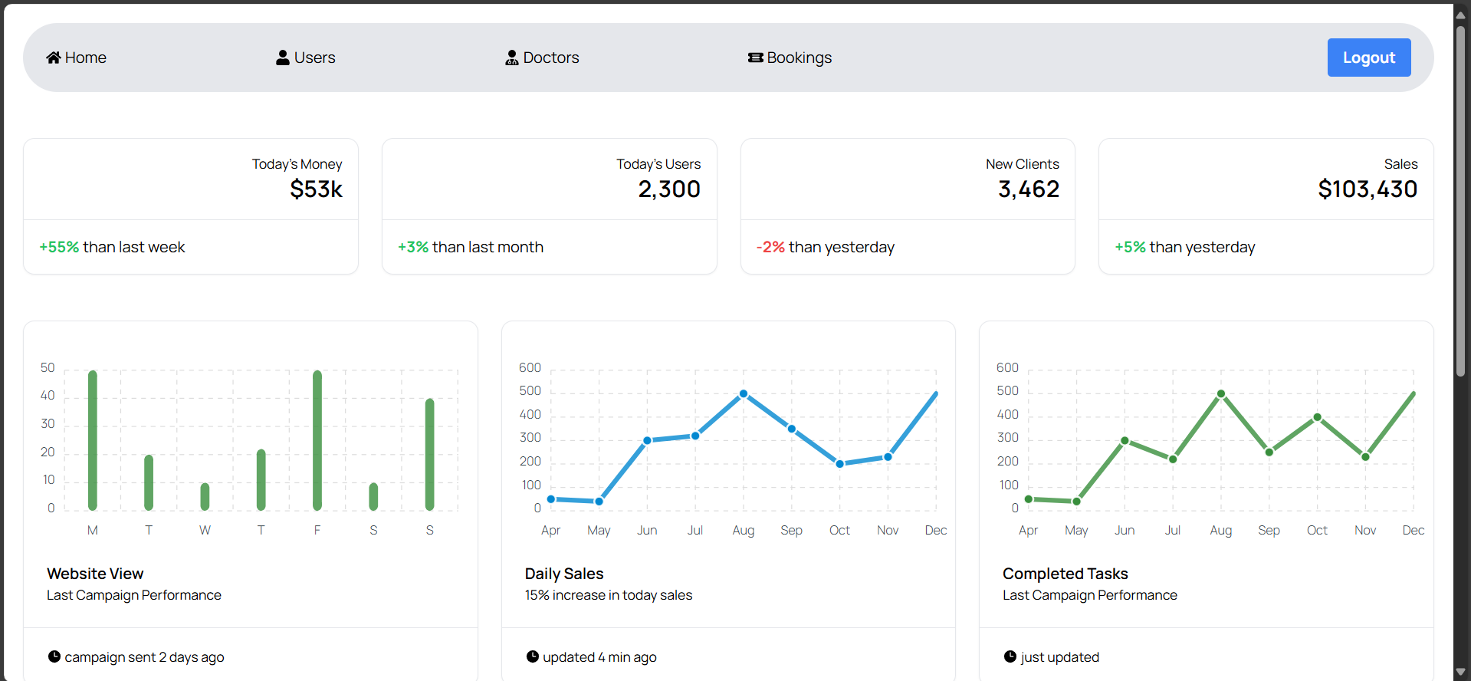
KEY MODULES
Admin Dashboard:

Slide 13
KEY MODULES
Admin Dashboard
Monitor Lab Tests, Appointments, Payments: Admins can track all lab activities, patient bookings, and fee transactions in real-time for complete transparency.
Manage Users, Doctors, Lab Staff: Admins can add, update, or remove patients, doctors, and lab employees to keep the system organized and secure.
Generate Overall Performance Reports: Admins can create detailed reports to analyze lab efficiency, doctor performance, and financial summaries to improve services.

Slide 14
HOW AI-MED LAB WORKS
Step 1: Patient submits sample for testing Step 2: AI analyzes and generates report Step 3: Patient views report and books a doctor if needed Step 4: Doctor reviews report, consults patient, charges fees Step 5: Admin oversees all activities and ensures smooth workflow

Slide 15
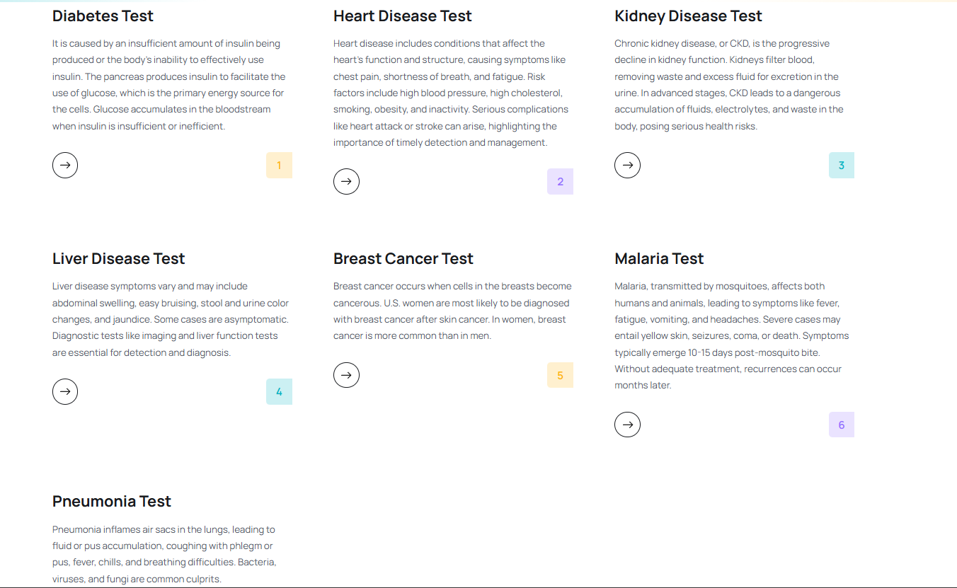

Slide 16
BENEFITS
Accurate and quick diagnostics
Easy access to doctors anytime
Simple and secure fee payment
Complete transparency for admin
Efficient lab and clinic management in one place

Slide 17
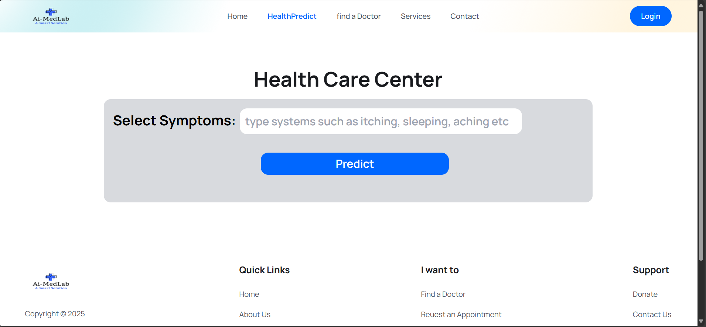
AI-MODEL
Accurate and quick diagnostics
Easy access to doctors anytime
Simple and secure fee payment
Complete transparency for admin
Efficient lab and clinic management in one place

Slide 18
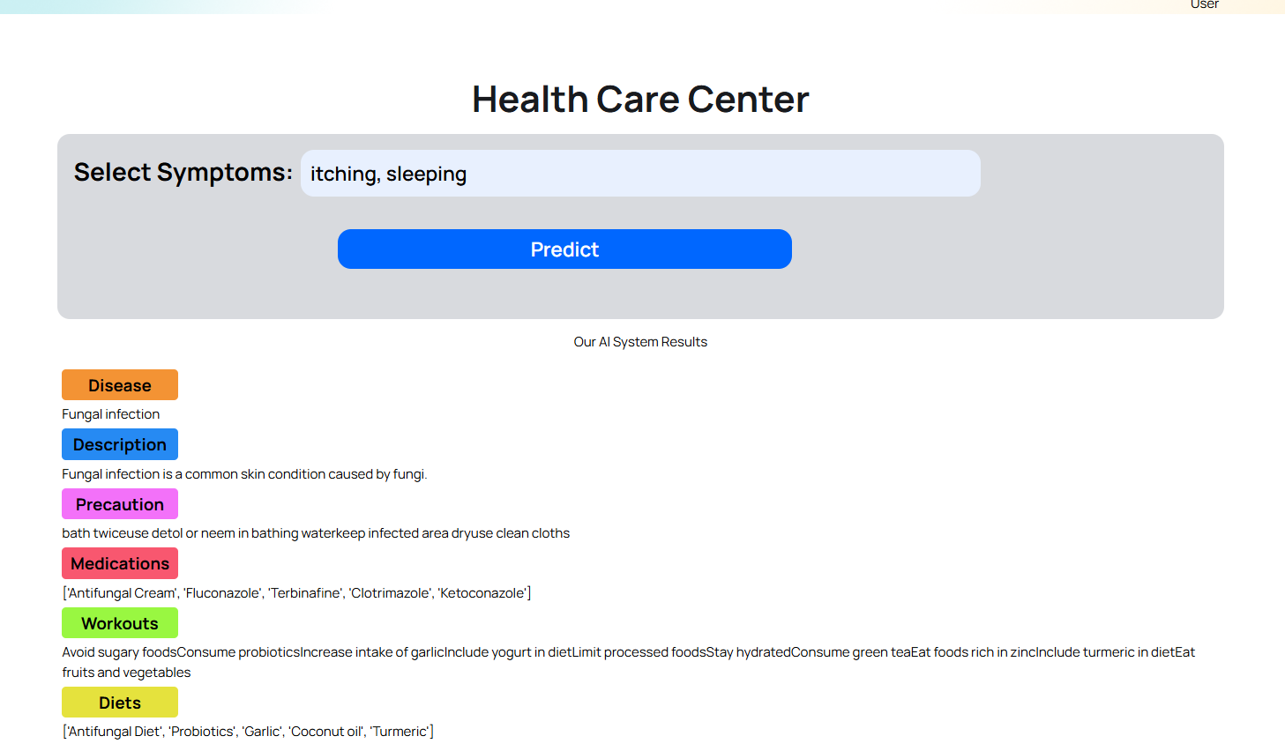

Slide 19
CONCLUSION
AI-Med Lab is a smart healthcare platform — combining AI diagnostics, doctor appointments, secure payments, and complete admin control to ensure quality care for everyone.

Slide 20


